Slide 1
PRESENTATION ON
BACK END PROJECT
JSP CRUD OPERATIONS
By:
Aparna Mukrut
Guided By:
Jayanth V. Sir

Slide 2
Contents:
Introduction of Project
Screenshots
Conclusion

Slide 3
Introduction:
In this Back End project I have design a JSP CRUD operation application using JSP.
We can Create new user.
We can Read all the records.
We can Update user.
We can Delete the records.

Slide 4
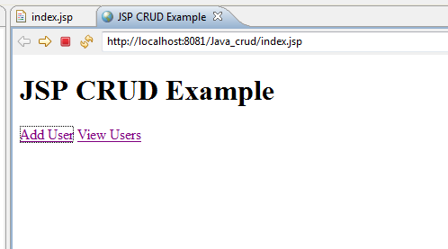
Index Page:

Slide 5
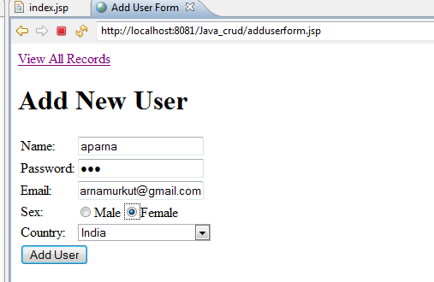
Add User Page:

Slide 6
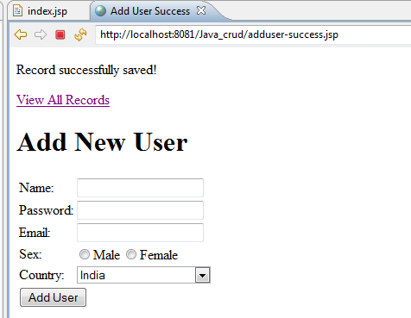
Record Successfully Saved Page:

Slide 7
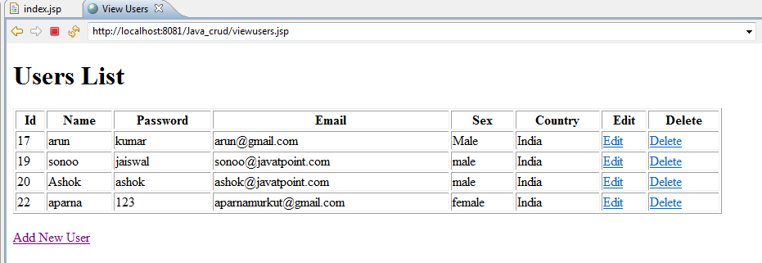
View All Records Page:

Slide 8
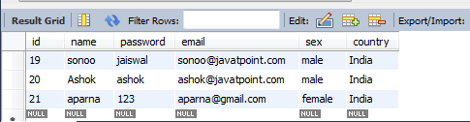
Record saved in database Page:

Slide 9
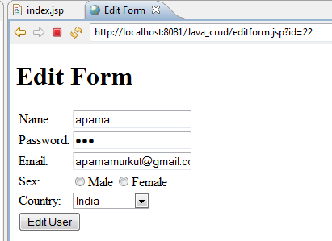
Edit Form Page:

Slide 10
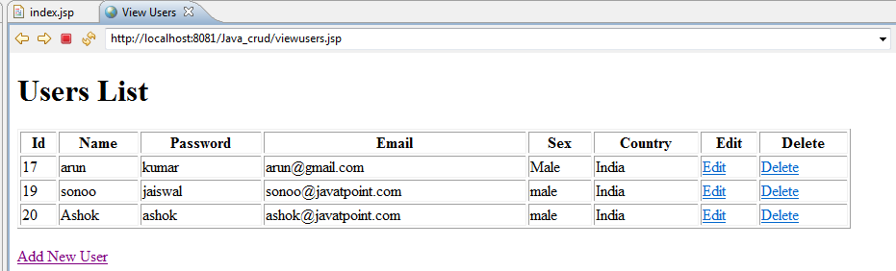
Record Deleted Page:

Slide 11
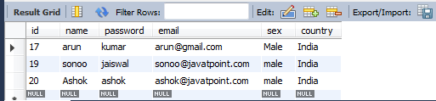
Record Deleted in Database Page:

Slide 12
Conclusion:
The purpose of this project is to make user friendly Application for Create, Read, Update, Delete operations on database.

Slide 13
Thank You…

